Slide 1
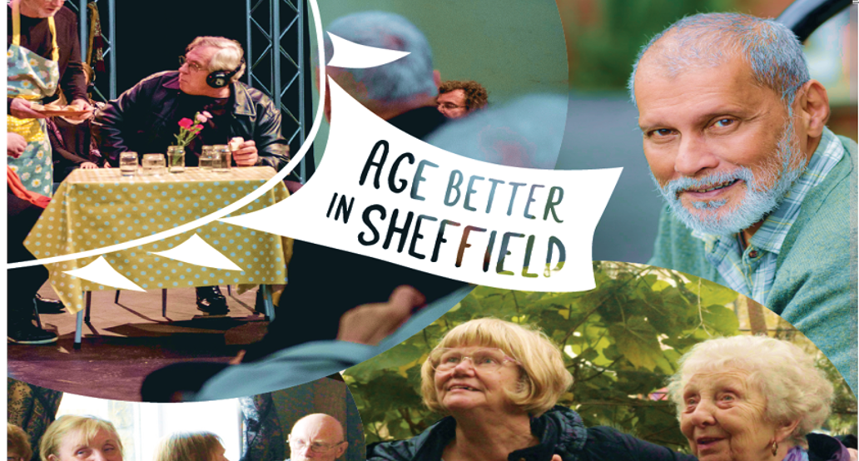
Emotional Wellbeing Practitioners Project
Presentation for Research and Policy Hub Meeting, Psychology of Loneliness
Edyta Bancer, Programme Delivery Manager

Slide 2


Our story
We love helping to make Sheffield a city we can all be proud to grow older in. In partnership with lots of organisations across Sheffield we’re delivering innovative and exciting projects to help tackle loneliness and social isolation for people aged 50 and over. We’ve made it our mission to support individuals to develop positive and meaningful connections with others.

Slide 3
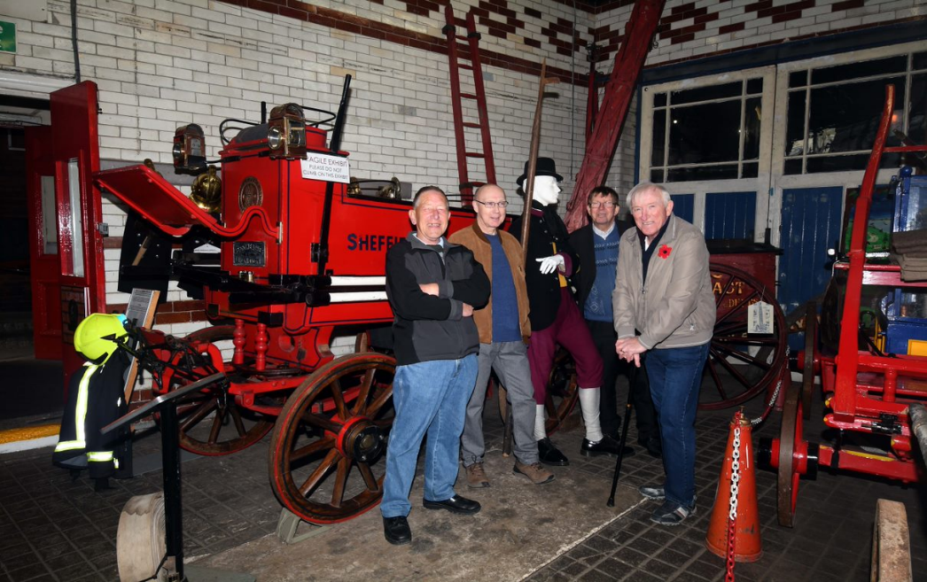
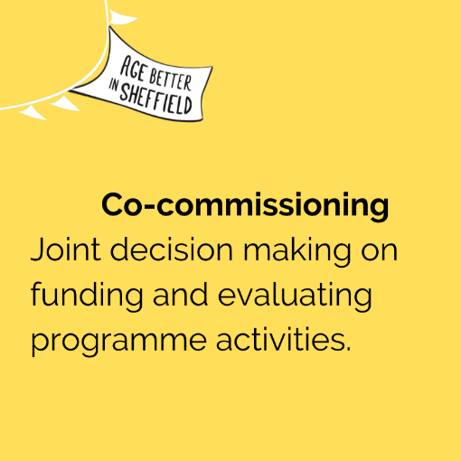
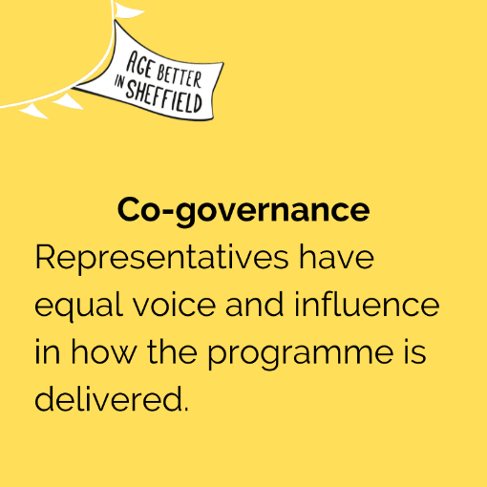
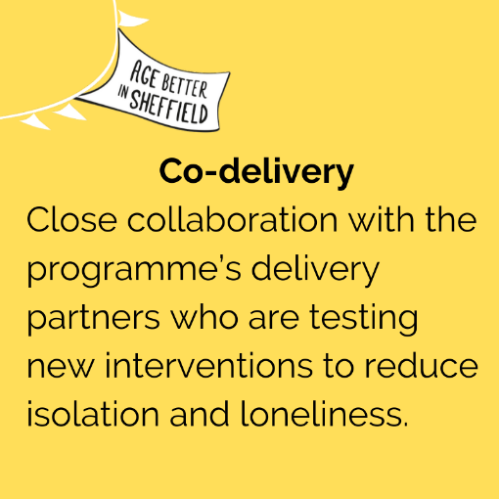

Older people leading the way

Slide 4

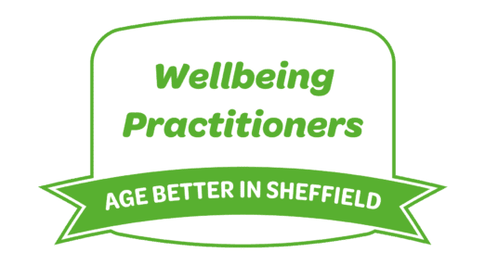
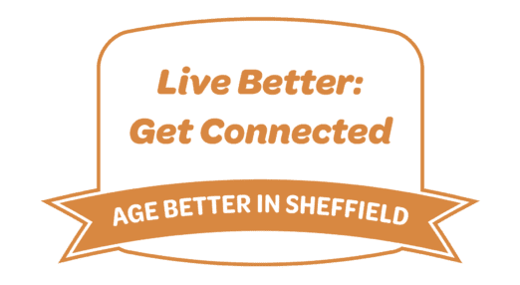


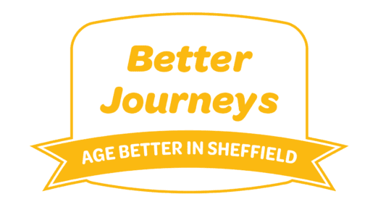
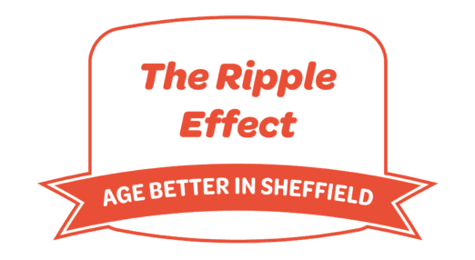


Our projects
Opportunity to collaborate with 3rd sector & arts organisations across Sheffield
Testing out a range of innovative interventions
Co-designed and delivered projects
Focus on key issues of bereavement, access to resources/impact of austerity/ travel & accessibility/employment and making Sheffield a more Age Friendly place to live.

Slide 5
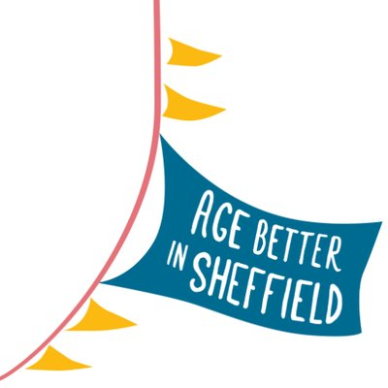
Wellbeing Practitioners
Wellbeing Practitioners is a service we’ve proudly offered since the beginning of the Age Better in Sheffield programme, and it has had wonderful results for many people living in Sheffield.
The service can be provided in client’s own home or at a community venue in Sheffield and is delivered by professional counsellors from Sheffield Mind – a local charity who know that good mental health is fundamental to living a healthy and fulfilling life.
Having someone to talk to can really lift a weight off individuals’ shoulders, and our Wellbeing Practitioners will support clients with practical ways to build resilience, confidence and improve their wellbeing.
This service is for anyone in Sheffield who is aged 50 or over and who would benefit from talking to someone and accessing professional counselling or therapy. The project is designed for somebody who has become socially isolated due to experiencing low mental wellbeing or might not feel confident enough to leave their house.

Slide 6
The service has changed its delivery method over time to reflect learning, for example moving to offering therapy in six week blocks (with potential for extension) rather than an initial offer of 26 weeks.
• The project was recommissioned in 2018, with an increased focus on creative and movement therapies as well as group therapy.
• Sheffield Mind were also part of a consortium delivering a second Age Better in Sheffield intervention, Peer Mentors, which matched people who had experienced loneliness and isolation with people currently experiencing or at risk of loneliness and isolation
https://www.youtube.com/watch?v=-dS9FZYQoyU&t=75s

Slide 7
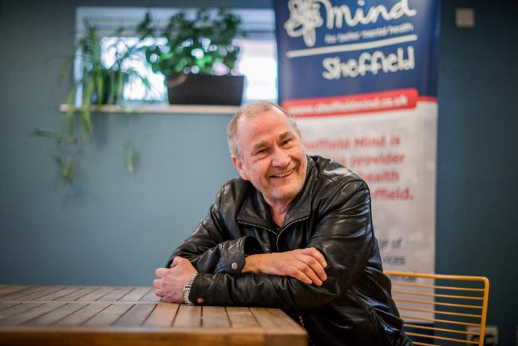
Participants tended to experience a sense of loss of some kind resulting from a change in life circumstances, including bereavement, ill health and caring responsibilities

Slide 8
Methods of evaluation
• As part of the Ageing Better: Fulfilling Lives project, Wellbeing Practitioners is being evaluated using a mixed methods approach.
• Learning has also been drawn from a focus group carried out with Wellbeing Practitioners staff.
• Quantitative evaluation is carried out using the national Ageing Better: Fulfilling Lives Common Measurement Framework which measures a range of indicators including loneliness and isolation (using De Jong Gierveld 6 item scale and UCLA scales) and wellbeing (SWEBWBS). A survey tailored to Wellbeing Practitioners is also completed, and Sheffield Mind also sent out a separate questionnaire to participants.
• Coproduction, including co-evaluation, is a key to Age Better in Sheffield, and qualitative evaluation to date has involved interviews and focus groups carried out by volunteer researchers aged over 50 and carried out with participants and practitioners.

Slide 9
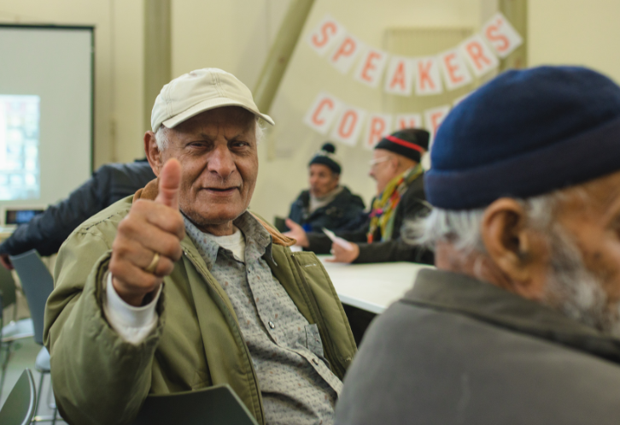
Outcomes
• 80% of Wellbeing Practitioners’ clients during the first three years have improved in wellbeing (80% on SWEMWBS). 62% demonstrated improvements in EQ-VAS health self-reported score.
• Responding to a questionnaire devised by Sheffield Mind, 61% of respondents reported visiting their GP less frequently for their mental health concerns (one client reported a reduction from weekly visits to every two months).

Slide 10
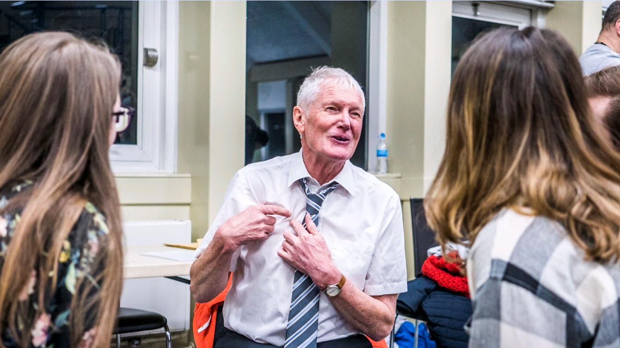
Ageing Better programmes across the country have identified that it is much harder to reduce loneliness and isolation than wellbeing, but 47% improved on De Jong Gierveld 6 item scale, the highest of Age Better in Sheffield interventions, and 52% improved against the UCLA loneliness scale.
45% of participants increased social contact with family members, and 43% increased social contact with non-family members. In a questionnaire devised by Sheffield Mind, 78% of respondents reported more regular contact with family, friends, colleagues, neighbours or others in their community.

Slide 11
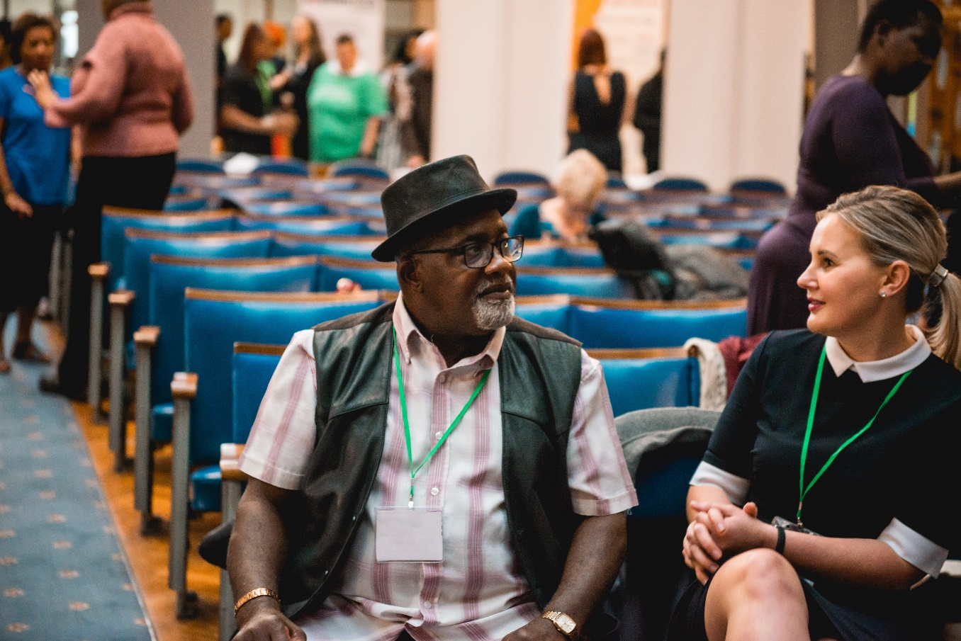
Wellbeing Practitioners have worked hard to increase access for men, who are typically under-represented in psychological treatment: the percentage of male clients has increased by 13% between year 1 and year 5.
Involvement in Wellbeing Practitioners has influenced Sheffield Mind’s approach to therapy in many ways. A greater focus on working with older adults has helped practitioners to understand the most effective ways of working with them and the challenges that are presented.

Slide 12
“It didn’t completely wipe out my problems and my mental health but it just made me aware of why I think the way I do, and helps me to find strategies to cope with how I feel with depression on a day to day basis, and also to understand others and to sympathise and empathise with people.” (Joanne)

Slide 13
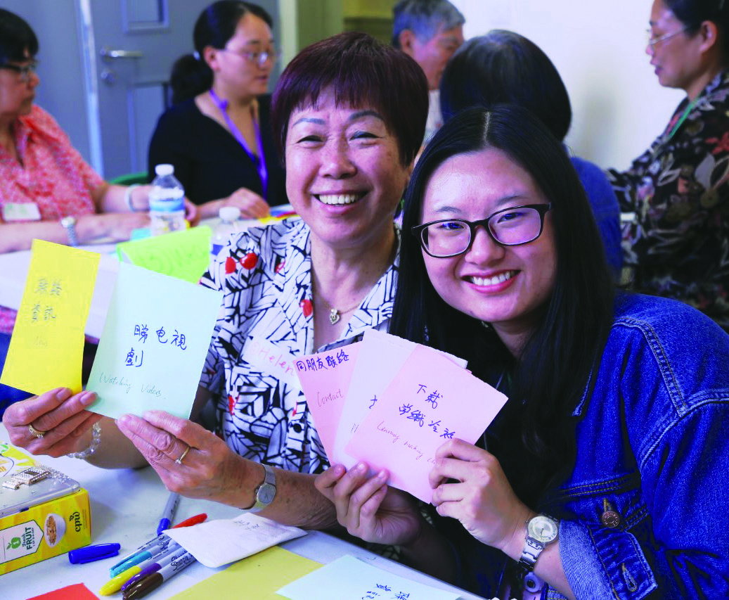
Learning
Over the course of the programme, clinicians and Age Better in Sheffield have gained in learning about the potential for counselling to reduce loneliness and isolation and improve wellbeing:
Loneliness isn’t always solved by reducing isolation: improving people’s sense of wellbeing and rekindling an interest in hobbies can make people feel less alone even if they remain physically isolated.
Challenges for older adults in accessing therapy include stigma and fear around mental health and what mental health practitioners might mean for them: fear of ‘men in white coats’ and the recollection of time of asylums.

Slide 14
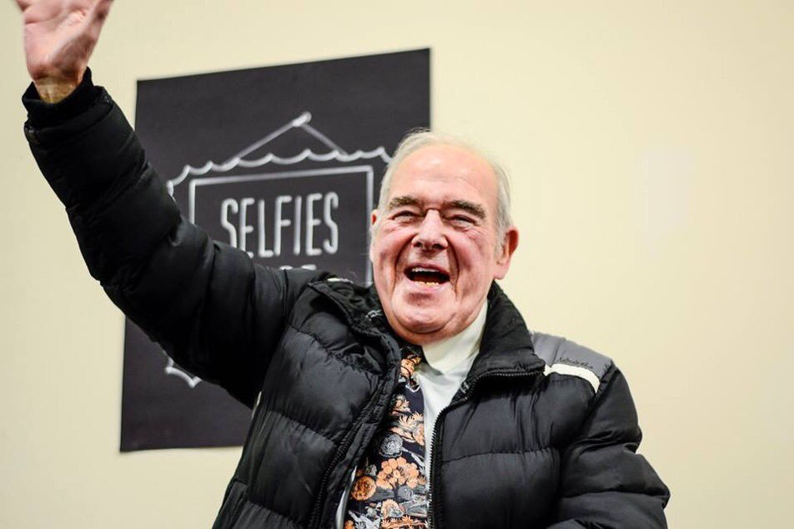
A male clinician having a regular slot on local radio appears to have been influential in increasing uptake amongst men, as well as having male counsellors.
Many people need a substantial period of therapy, but offering counselling in six week blocks with reviews (and the potential to have further blocks) has reduced the average number of counselling sessions that people receive before they are happy to end
Therapy delivered at people’s home enables people who would not otherwise to access therapy to do so. Therapists have learned that delivering therapy in someone’s home needs to be tailored to the environment. Expectations of outcomes for those who receive therapy at home may be different to those who are already able to function within the community
Early indications suggest that group therapy is not successful for those who have not already received individual therapy, particularly amongst people from lower socio-economic backgrounds and of white British ethnicity. Group interventions appear to work better for those who have already received a short period of individual therapy.

Slide 15
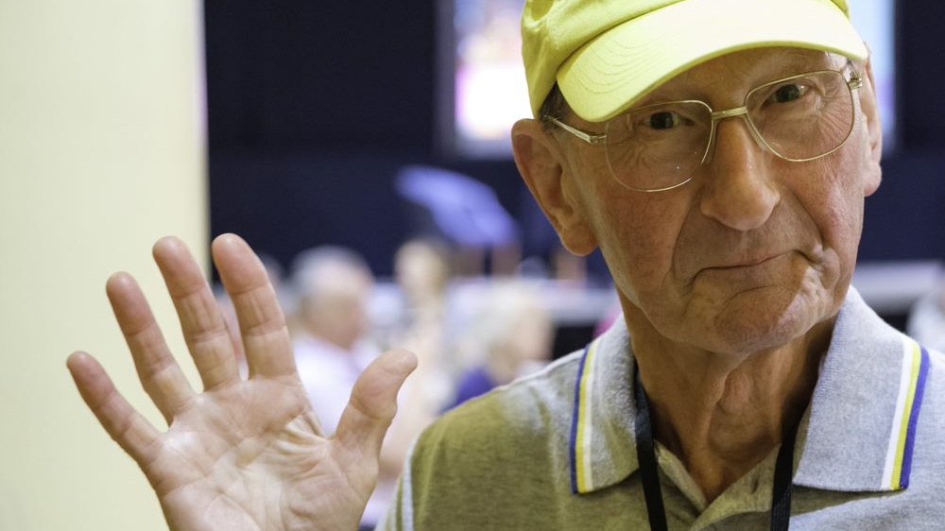
Thank you!
We’d love to connect with you to share learning on Ageing Better.
Get in touch!
@agebettersheff
www.agebettersheff.co.uk
e.bancer@syha.co.uk

