Slide 1



Campaign to End Loneliness
Research Hub
23 January 2015

Slide 2
Agenda
13.30 – 14.00 Arrivals & Coffee
14.00 – 14.25 Welcome & Introductions
14.25 – 15.05 The Behavioural Insights Team & Public Health England
15.05 – 15.30 Deborah Morgan, Swansea University
15.30 – 15.45 Coffee
15.45 – 16.10 Dr Adrian Adams, University of Kent
16.10 – 16.35 Dr Mary Pat Sullivan, Brunel University
16.35 – 16.50 Update from the Campaign to End Loneliness
16.50 – 17.30 Drinks & Networking

Slide 3
Introductions

Slide 4
Presentation & Discussion
Behavioural Insights Team & Public Health England
Michael Hallsworth
Antonio Silva
Dr Tim Chadborn
Annie Murray

Slide 5

Reducing Loneliness
Antonio Silva, Michael Hallsworth & Tim Chadborn
Notes:
Loneliness and social isolation present a serious risk to public health.
Lack of good evidence on what works, few large scale RCTs
The few good studies show little impact on reducing loneliness
Based on a combination of our literature review and insights from other areas, we came up with interventions in 3 areas. One is based on cognitive behavioural therapies which have shown to be one of the most promising areas. 2nd is adding agency to people, by getting them to help other people, instead of just being passively helped. And finally, we decided to target men specifically, as most interventions tend to be primarily aimed at women, or at least women are the main beneficiaries.
A key aspect to all of our work is to be empirically solid, as so we have designed a randomised control trial to test our interventions and what we will show you is the current design of the project which we hope to have running over the next few months.

Slide 6
Trial Design
Mindfulness
Interventions
50%
Befriending others
Men in Sheds
Above cut-off score
Usual care (control)
50%
Identification
(GP or automated)
Below cut-off score
Notes:
Loneliness and social isolation present a serious risk to public health.
Lack of good evidence on what works, few large scale RCTs
The few good studies show little impact on reducing loneliness
Based on a combination of our literature review and insights from other areas, we came up with interventions in 3 areas. One is based on cognitive behavioural therapies which have shown to be one of the most promising areas. 2nd is adding agency to people, by getting them to help other people, instead of just being passively helped. And finally, we decided to target men specifically, as most interventions tend to be primarily aimed at women, or at least women are the main beneficiaries.
A key aspect to all of our work is to be empirically solid, as so we have designed a randomised control trial to test our interventions and what we will show you is the current design of the project which w ehope to have running over the next few months.

Slide 7
Identification
GP identification
  GPs identify people they believe are lonely
  Ask if they would like to potentially get involved in community activities, if capacity allows
  If person agrees, the GP asks them to sign a consent form and passes details on the project team
Automated identification
  Receptionist offers tablet to people over 55 to fill in survey while they wait
  People fill in short survey based on loneliness survey scales
  People agree to be part of study and score above certain threshold, will be contacted by the project team

Slide 8
Interventions
Mindfulness
  Addresses the negative thought patterns that may be impeding the creation of fulfilling relationships.
  Delivered by Breathworks
Befriending others
  Participants volunteer with RVS’s befriending scheme
  Helping other people increases individual well-being
Men in Sheds
  Targets men
  Alternatives available

Slide 9
Advantages
Large-scale evidence based trial
Good evidence of causality
Objective and subjective health measures:
  Reduced GP visits
  Reduced prescriptions
  Loneliness scales (UCLA / De Jong / CTEL)
Scalable
Relatively low upfront cost
Notes:
Feedback welcome
Potential partners are also very welcome
New measures, possibly the new one by Campaign

Slide 10
Antonio Silva antonio.silva@behaviouralinsights.co.uk
Tim Chadborn tim.Chadborn@phe.gov.uk
www.behaviouralinsights.co.uk www.phe.gov.uk

Slide 11
Presentation & Discussion
Deborah Morgan
Swansea University
MorganD25@cardiff.ac.uk

Slide 12


Slide 13

Transitions in Loneliness and Social Isolation
Deborah Morgan
PhD student
Supervisors: Prof Vanessa Burholt
Dr Stephen Drinkwater

Slide 14
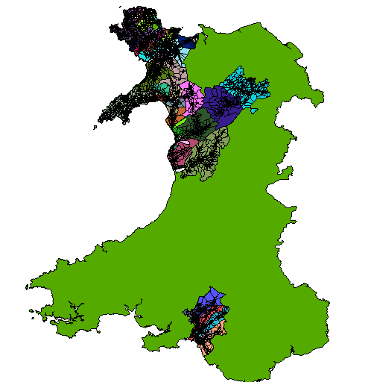
Mixed Methods Study
Quantitative data –Pre-release interim data set from CFAS Wales.
Qualitative Data-Narrative interviews with 11 participants selected from CFAS Wales Wave One
CFAS –Wales Study Area Map (OS Master Map)

Slide 15
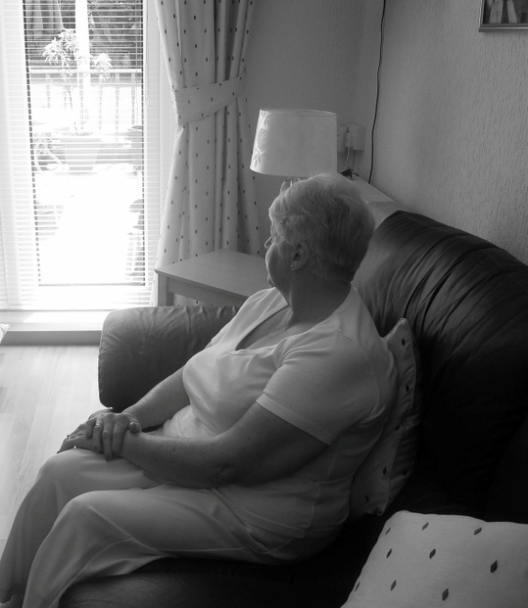
Aims of the study
To identify the psychosocial risk factors that predicted inclusion in one of four previously identified categories of loneliness and social isolation
To explore transition and stability in loneliness and social isolation from the perspective of older people themselves.

Slide 16
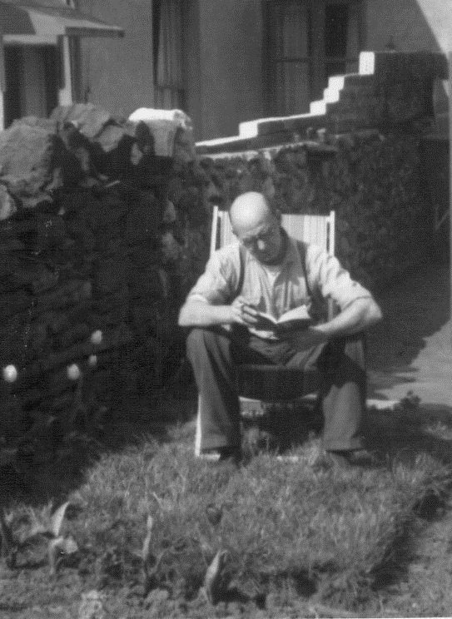
Risk Factors for Loneliness and Social Isolation*
Socio demographic Factors
Age*
Gender
Living alone*
Marital status*
Availability of family and friends
Financial Resources*
Housing Tenure
Educational level
Access to a car
Health Factors
Functional status*
Disability*
Being a carer
Perceived health
Depression
Onset of illness
Cognitive impairment*
Life Events
Widowhood
Admittance to a care home*
Retirement migration
* Also risk factor for social isolation
Social Isolation as Function of Location
Urban /rural risk factors
Lack of accessible transport
Lack of local facilities

Slide 17
Variables Included in Analysis
Socio-demographic
Gender
Age
Marital status
Tenure*
Length of time lived in area*
Education
Household composition*
Children
Social
Proximity to family
Participation church and social
Health
Self rated health
Sadness/depression
Disability **
Psychological
Self esteem
Interpersonal control
Location
Rural Urban
*Not significant
** dropped due to singularities

Slide 18
Prevalence of Loneliness and Isolation
De Jong Gierveld Loneliness Scale
Lubben Social Network Scale
 | Frequency | Percent
not lonely (0-1) | 1976 | 75.0
lonely (2-6) | 658 | 25.0
Total | 2634 | 100.0
 | Frequency | Percent
Isolated -no | 1797 | 68.2
isolated- yes | 837 | 31.8
Total | 2634 | 100.0

Slide 19
Prevalence of Loneliness and Social Isolation: Four patterns of loneliness
 | Frequency | Percent
not lonely not isolated | 1475 | 56.0
lonely not isolated | 322 | 12.2
isolated not lonely | 501 | 19.0
lonely and isolated | 336 | 12.8
Total | 2634 | 100.0

Slide 20
95% CI for Odds Ratio
 | β (SE) | Lower | Odds Ratio | Upper
Lonely and Isolatedª
Intercept | -.151(.716)ns
Sex-Female | -.571(.152)*** | .419 | .565 | .762
Age 65-74 | -.465(.237)* | .395 | .628 | 1.000
Marital- married/cohab | -.720(.261)** | .292 | .487 | .811
Children-no | .861(.240)*** | 1.477 | 2.366 | 3.790
Sadness/depression-no | -1.107(.256)*** | .200 | .331 | .546
Health-excellent | -1.000(.308)** | .201 | .368 | .672
Self-esteem Q1 | .783(.232)** | 1.390 | 2.188 | 3.447
Interpersonal control Q1 | 1.597(.315)*** | 2.662 | 4.939 | 9.164
Interpersonal control Q2 | 1.253(.307)*** | 1.917 | 3.502 | 6.396
Interpersonal control Q3 | .620(.300)* | 1.033 | 1.859 | 3.344
Attend church/social -no | 1.059(.158)*** | 2.117 | 2.884 | 3.928
Proximity-within 1 mile | -1.254(.196)*** | .195 | .285 | .419
MLR Model
ª Reference category not lonely not isolated- default categories are male; 85>years; divorced/separated; high education; lived in area a long time; lives with someone-yes and children-yes; attends church/social-yes; Lives >50 miles; Hamlet/isolated dwelling Nagelkerke .280- ns- not significant;
* p< 0.05;**p< 0.01; *** p<.001

Slide 21
Results Multinomial Logistic Regression Models
Lonely not isolated category
Frequent feelings of sadness /depression
Having low self-esteem
Living more than 50 miles from family
Isolated not lonely category
Advanced age( 85 years +)
Low level of education (school leaving cert or less)
Childlessness
Poor health- self assessed
Low self-esteem
Low level of interpersonal control
Non-participation in church/social groups
Living more than 50 miles from family
Living in a less sparse hamlet or isolated dwelling

Slide 22
Results - Multinomial Logistic Regression Models
Lonely and isolated
Being male
Being single or divorced
Advanced age( 85 years +)
Low level of education (school leaving cert or less)
Childlessness
Poor health- self assessed
Low self-esteem
Low level of interpersonal control
Non-participation in church/social groups
Living more than 50 miles from family
Living in a less sparse hamlet or isolated dwelling
Not lonely not isolated
Being female
Married
Being younger (65-74 years)
Having children
Positive assessment of health
Not sad/depressed
High self-esteem
High level of interpersonal control
Active participation in church/social groups
Close proximity to family

Slide 23
Understanding Degenerating loneliness as a biographical disruption
Bury (1982) Three aspects of Biographical disruption :-
'the disruption of taken-for-granted assumptions and behaviours', leading to the question 'what is going on here?' (1982: 169)
disruptions in explanatory systems normally used by people, such that a fundamental re-thinking of the person's biography and self-concepts is involved' (1982: 169)
'the way in which individuals respond, a process which involves 'the
mobilisation of resources in facing an altered situation' (1982: 170)

Slide 24
the kind of experience where the structures of everyday life and the forms of knowledge which underpin them are disrupted” (Bury1982:169)
well it came as such a shock when she did leave that I just had to rethink my whole life and as I say I’m just beginning to get it back together again, erm, so you have to find ways of coping with it, forcing yourself to make contact with other people (Male 78)
that’s all I’d ever known. I remember thinking about a week later, coming down the stairs I thought, and I took my wedding ring off, and I thought “I’m not married anymore”, I’d been married since I was 16, I’d never known anything else, “I’m not married anymore” and then I thought, no, no, put the ring back on. It was a weird thought in your head like, to come, when a situation arises that you’ve never been used to, yeah….. And then I was afraid of anybody wanting to be friendly with me, like, (Female 67)
because when you’ve lived with somebody and known somebody that long it just shattered me, it did, the fact that she went and no other reason than sex

Slide 25
disrupts personal expectations and plans and the structures of everyday life, requiring ‘a fundamental rethinking of the person’s biography and self-concept’ ( Bury 1982: 169)
I wasn’t prepared for it so I just had to sort of make it up, make up living on my own as I went along and I’d have these sort of moments of absolute desperation when I thought “I’ll have to get her back, I’ll have to get her back, try and you know”, (Male 78)
( loneliness) it’s more now, more now.
what do you think’s changed?
mainly realising that life’s not the same, life has changed, you know, and I can’t live it the way I was living it before……I don’t know, because life is so different now than what it was, I don’t know, they say time will tell, but to me time has gone, it’s gone worse as time has gone on.( Female 67)
well my brother lives up the farm up there and now and again I phone him up to say something, and he’ll say “oh for Christ’s sake shake up” because I’m not a person really, I never thought I’d get to the state I’m in now (Male 74)

Slide 26
prompts mobilization of resources from social network members, "bringing individuals, their families, and wider social networks face to face with the character of their relationships in stark form, disrupting normal rules of reciprocity and mutual support” (Bury 1982:p. 169).
see the others don’t care a monkeys they don’t, all they want is “how much have he left me?” I’ve got a granddaughter that passes here about twice a week to go to town, if she’s on foot and she goes down through there and she don’t come here. I said to her in town, “that’s all right love, not bothered if you don’t come, but don’t expect nothing when I snuff it because you just walk past my house, so my house will walk past you when I’ve died” (Male 74)
my daughter, well she’s got three children she haven’t got time to feel it, but she doesn’t show, she don’t want to know, you know, she just brushes it aside and you know, because hurting isn’t it, just brush it aside (Female 67)

Slide 27
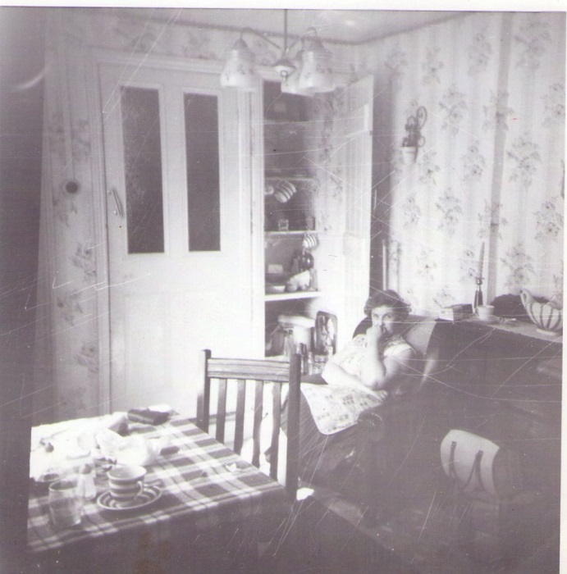
Key Points
Number of risk factors were found to be predictive of inclusion in one of four patterns of loneliness and social isolation.
Degenerating loneliness can be understood as a “biographical disruption” (Bury 1982)
Bury, Michael. 1982. “Chronic Illness as Biographical Disruption.” Sociology of Health and Illness 4:167–82.

Slide 28
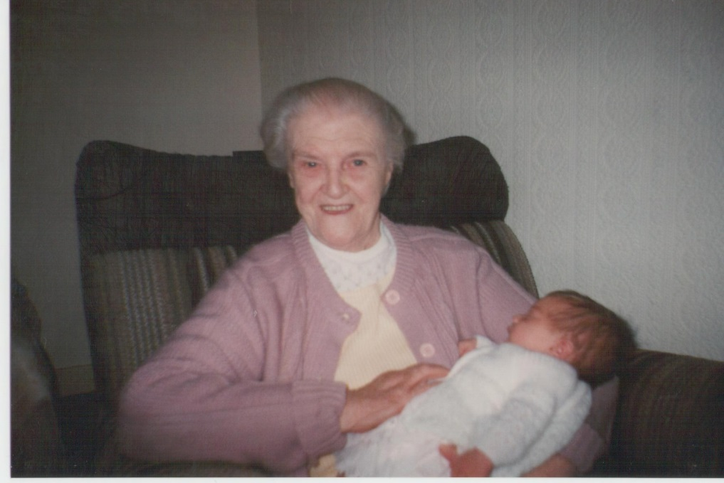
Thank You for Listening
Email: 575308@swansea.ac.uk

Slide 29
Tea & Coffee Break

Slide 30
Presentation & Discussion
Dr Adrian Adams
University of Kent
A.Adams@kent.ac.uk

Slide 31

[
Hidden Citizens
Anna Goodman (Campaign to End Loneliness), Hannah Swift & Adrian Adams (University of Kent)
Outline
Methodology
Findings
Pathways into Loneliness
Discussion Points
Recommendations: Service Development & Research

Slide 32
Study Outline
2013, the Campaign consults 100 + frontline services about what they needed to improve their effectiveness and efficiency
50% request a tool / information to help identify those at risk of loneliness.
2014 “Hidden Citizens” funded by SSCR aimed to:
identify how service commissioners and providers and local communities can recognise signs of loneliness amongst older people, and
explore how recent research or tools can help policy makers and practitioners to improve their outreach to the most isolated / detached older adults.
2 Stages: 1 - Review of Reviews and 2 - Interviews and Focus Groups with: Service Commissioners, CEOS, Managers, R&D, Practitioners, Carers, Users and sample of 65 +.

Slide 33
Methodology Review of Reviews
128 articles were selected based on the following selection criteria:
The article related in full or in part to older people. Because of the subjective nature of age categorization and defining when old age begins, the term was defined by the studies identified.
The article related in full or in part to exploring loneliness and / or social isolation and / or social exclusion of older people
Only articles published in 2000 or later were included
Only published articles were included (i.e. papers from conference proceedings were excluded)
From this initial collection, the findings from 17 review articles and 5 abstracts were identified and analysed with a focus on identifying risk factors for loneliness, and pathways into and out of loneliness. In addition to this, the insights from eight intervention studies were used to evaluate how best to practically identify and recruit lonely participants for studies

Slide 34
Methodology Review of Reviews
3 Google Scholar searches ‘loneliness & old age’ ‘social isolation & old age’ & ‘social exclusion & old age’
54,700, 231,000 and 383,000 hits
Related in full or in part to older people (as defined by studies).
Related in full or in part to exploring loneliness and / or social isolation and / or social exclusion of older people.
Published in 2000-14
Only published articles were included (i.e. papers from conference proceedings were excluded).
Approx. 480 ‘relevant’ articles identified
352 excluded on basis of first set of selection criteria
22 review articles, 57 surveys, 8 interventions
128 articles obtained for database
106 excluded on basis of second set of selection criteria
22 articles included in the review (17 full, 5 abstracts)

Slide 35
Methodology Interviews & Focus Groups
From the key issues identified from the literature review, a semi-structured schedule was developed to explore the participants’ perceptions of loneliness.
4 focus groups
16 telephone interviews:
  older people (n=9)
  CEO’s national / local charities (n=4)
  LA commissioners & managers (n=5)
  Research/data managers/analysts (n=3)
  Community development manager (n=1)
  Domiciliary & residential care service providers (n=9)
  Direct care staff (n=8)
Concurrent data collection and analysis, interviews taped & transcribed, themes identified and compared, independent coding

Slide 36
Pathways into Loneliness
Loneliness is likely to be culmination of one or more factors, or set of circumstances. Key factors are both intrinsic, i.e. a property of the individual, and extrinsic, i.e. some external event or circumstance that impacts on the individual.
Swift H. 2014
Intrinstic
  Personality
  Psychological response
  Social group membership
Extrinstic
  Life events, traumas
  and transitions
  Environmental factors
  Personal circumstances

Slide 37
Configurations of factors can make preventing or alleviating loneliness very complex Swift H.2014
Loneliness
Personality
Psychological response
Life events, traumas and tranistitions
Environmental factors
Personal circumstances
Social group membership
Intrinsic
Extrinsic

Slide 38
Pathways in and out of loneliness
Discernible pathways into loneliness commence with a significant loss of relationship compounded by the experience of other social losses which in turn lead to a loss of self confidence and identity
Less clear is if existing individual services alone can provide pathways out of loneliness
Increasing use of first contact tools to identify older people who are experiencing loneliness and in need of greater support. Not yet fully adopted across all services, networks or localities and not fully evaluated for its effectiveness / impact
Identification without effective strategies for reaching, building relationships and promoting participation may be of limited value

Slide 39
Findings Summary
From the Interviews 7 broad categories of answers emerged:
Understandings of and approaches to loneliness
Service organisation aims and objectives, characteristics and methods of intervention.
Strategic commissioning priorities and innovations
Methods for the identification of loneliness
Service models & interventions for addressing
Organisational approaches to data capture including service outcome measures and evaluations
Working in partnership and networks with others.

Slide 40
Correlations with the review
Need for valid indicators for measuring loneliness and focus on both short and long term outcomes (Honigh-de Vlaming et al., 2013)
Promoting Opportunities for reciprocity: (Cattan et al 2005)
Coproduction with the intended target group before intervention (Findley, 2003; Cattan et al 2005; Dickens et al 2011)
Utilisation of existing community resources and aim to build community capacity (Findley, 2003, Honigh-de Vlaming et al., 2013).
Interventions that offer social activity and / or support with a group format were more effective (Cattan et al 2010)
Need for interventions to reduce maladaptive social(Masi et al 2010)

Slide 41
Discussion points
Loneliness as a growing and serious social problem in an increasingly complex and fragmented operating environment
Services are acquainted with emerging evidence on social isolation, loneliness associated risks but less clear about how & which specific interventions / services were effective.
Service Commissioners focused on funding forms of intervention, building community capacity that identify & address needs based on health & social care risk factors & targets - Community Schemes & services more concerned with developing a flexible & intuitive services that respond to individual & situated needs
Problematic was:
The lack of measures to identify & responded to situated social isolation and loneliness and persistence of single task centred services and models, rather than relational or person centred, integrated, flexible support across the service system.
Need for relevant & reliable data, improved dissemination & adoption of innovative approaches, and service impact evaluations

Slide 42
Loneliness is an individual experience recognise the psycho-social element of loneliness don’t assume all people going through a particular life event or transition will respond in the same way
Context is Key
- This requires a better understanding of how a service, intervention or tool operates in a particular context
Focus on “business as usual” methods
– as budgets & income are squeezed, improving communication and integration will improve identifying loneliness as part of day-to-day services
Be aware of the macro , meso and micro dimensions of loneliness
Recommendations: service development

Slide 43
Recommendations: future research
Research has mainly focused on extrinsic factors.
Of the 4 broad types interventions:
  i. Improving social skills , ii. enhancing social support, iii. increasing
  opportunities for social interaction and iv. addressing maladaptive social
  cognition - when tested, iv. was found to be the most effective.
Little evidence on how to use more than one strategy or pathway, i.e. there is a need to know more on a) how services can address both physical / practical barriers to socialising and personal or psychological causes of loneliness and b) how to combining intervention strategies, i.e. consideration of individual needs as well as providing opportunities for social interactions
Investigate and evaluate a social identity approach to reducing loneliness

Slide 44
3 Dimensions of Loneliness:
Micro: Individual Case Studies.
Utilising a range or inter-disciplinary approaches to explore pathways into / out of loneliness and social isolation.
Meso: Ethnographic studies of non familial related others.
Recognition and engagement with socially isolated & lonely older adults in a local neighbourhood.
Macro: Evaluations of multi-site and complex interventions.
To identify which combination of services provides the most compelling possibilities for change.
Recommendations: future research

Slide 45
Presentation & Discussion
Dr Mary Pat Sullivan
Brunel University
mary.sullivan@brunel.ac.uk

Slide 46
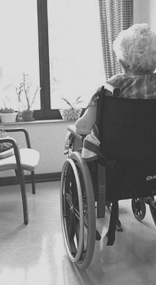
Talking about Loneliness
Mary Pat Sullivan
Christina Victor
Mike Thomas
Rachel Woodbridge
Department of Clinical Sciences
College of Health and Life Sciences

Slide 47
Why Explore Loneliness Qualitatively?
  “Loneliness, far from being a rare and curious circumstance, is and always has been the central and inevitable experience of every man [sic].” (Wolfe, 1940)
  Basic motivator to engage in our social worlds (Mijuskovic, 2012)
  What are the felt and expressed meanings associated with the experience of loneliness?

Slide 48
Sample
Secondary data analysis on a subset of participants from the Loneliness, Isolation and Living Alone in Later Life (ESCR Growing Older Programme) (N=24)
    Lonely
    Mean age 74
    13 females; 11 males
    Majority from southwest and southeast England
23 in-depth interviews from the Temporal Variations in Loneliness Pilot Study
    Variations in loneliness
    Mean age 71
    16 females; 8 males
    Southeast England
Notes:
- Also qualitative comments in survey

Slide 49
Accessing the private
Sorry – didn’t realise how miserable I’d get doing this. I’d like to withdraw from the study.
I think it’s a very difficult thing to quantify, because we’re talking about this friend of ours who, it’s sad for her because she does obviously feel very lonely, although she wouldn’t admit it I think///but then we have friends who are a similar sort of age...who are single and are just busy all of the time and never have time to be lonely. And I think perhaps it is something which you can’t quantify because it is something which is within oneself perhaps, one’s outlook on life.
Notes:
2nd quote – 67 year old, married, rated as lonely
Difficult to quantify yet so easily recognised in another
Friend would deny, but apparently unaware she was doing the same
Shame of being lonely; shame of being old and lonely
Talking about the importance of social relationships but also ‘internal’ experience – so is there less clarity regarding the distinction between social and emotional loneliness?

Slide 50
Awareness of the possibility…
I mean I could always go up and talk to the girl, the sisters, or go and talk to Sam and Catherine. There are several people if I felt lonely, which I don't. Or they'd come and see us/// I mean if I really felt lonely I'd take the dogs over to the common and I'd find someone to talk to very very quickly because we know so many people over there.
Notes:
69 yr old male
Has also rated himself lonely in quantitative element of the study
However, efforts for planned, or even accidental, engagement were necessary to escape the almost certain possibility of loneliness. Thus there appeared to be a heightened awareness that being alone and/or inactive was a trigger for loneliness, and the individual was responsible to manage or avoid the anticipated consequences – even if it meant a fortuitous opportunity to socialise.

Slide 51
Current research does and doesn’t capture how people talk about loneliness
///and I've found it really difficult [widowhood] the friends, and the girlfriends and all this, I still find it quite difficult being on my own sometimes because I sometimes sort of go to bed and feel lonely as I get in to bed. It's umm, yes, it's less umm, it's less sort of in your face or less to the forefront///But at least three or four nights of the week///I will go to bed about 11, and I'll sit and read for a good hour or so, with the radio on, and I'm sort of hoping I'm getting tired! ///I will switch the light off and go to sleep, but I often lie awake for an hour or more before I go to sleep, and during that time, umm, I'll be reviewing the day or thinking ahead, but also sometimes you know the loneliness bit specifically creeps in because of thinking about my wife and stuff like that, not every time, but it does come up.
///I'm probably, sort of 60/40, 70/30, night time I would think, yes, and obviously then, if I do have longer periods to myself, if I'm not particularly doing anything, something might crop up in the paper or as I'm doing something around the house, a memory///I think winter doesn't help normally because, in the summer, I can, I suppose, be more active and go out more.
Notes:
No doubt a loss which is managed with re-engagement in social activities to alleviate the pain
Keeping busy to avoid, but then times of acute awareness – as another person said is comes and it goes
So less clear trajectory but rather fluctuation in periods of loneliness capturing the dance
- quant questions are very focused; feedback from participants was that ratings in our survey were too simplistic to capture their situation.

Slide 52
Unique and complex
I suppose in an awful lot of people it could be soul destroying to be that lonely, to be on your own, with on one to talk to, nobody to care, and nobody to care for. I think that is quite a big part of it is there is nobody to care for. They’ve all got someone taking care of them, you know. I have never ever been so desperate as to want to not live any more///I fortunately haven’t got to that stage but I am a lonely person. And it’s a cold place as well. A real cold place. I don’t know what else to think about it. Because when I start to get that bad I look at what I can see now, trees and, and you can get a certain amount of strength, inner strength, from looking at nature.

Slide 53
Unique and complex
I’ve got everything but I haven’t got enough///If you love somebody for that many years, it’s a very lonely life. And it’s there every minute of the day, and it never gets any better///...I don’t know what it is, it’s just one of them things for me. It’s something as, what can I say, let’s put it down to loneliness of the heart. And that’s it. I mean everything I touch, everything I do she’s there.
Notes:
74 yr old similar situation to earlier gentleman who focuses on the loss in relation to loneliness creeping in at night whereas this man calls it loneliness of the heart. Interestingly, his health was declining and he was home alone more often. But also spoke of being more lonely away on holiday as in the hone he felt closer to his wife.
Is he more conscious of his loneliness due to health decline and more limited opportunities to socially engage?

Slide 54
Unique and complex
I suppose intellectually I can get down///I can understand it’s a different kind of loneliness with friends of mine that they’ve had when their husband or wife has died. I mean that’s a different kind of loneliness, it’s a great sense of loss. But I don’t think if I feel lonely it’s a sense of loss.
Notes:
75 year old single female
Is this a more psychological or internal engagement with loneliness?

Slide 55
The meaning can never convey all that is intended
I think being … feeling alone is that when … it is generally when stuff goes … if stuff has gone wrong and you really are on your own. You haven't got anybody to turn to and say, hey, okay, what we gonna do now, or this is going to be okay, it's all up to you to do it, you haven't got that shoulder to lean on. I felt very alone, and this probably sounds a bit daft, but I felt very alone with that storm a couple of weeks ago///I couldn't go out and there was nobody I could talk to either and thinking … to say it's okay, it's just the wind, it's not going to happen, umm, but when you're on your own in that situation, that's … that's feeling very alone.
Umm … I don't really feel lonely. As I say I feel alone sometimes but not lonely. I think if I was in the situation where I couldn't call anybody or nobody said they were going to ring me, yes, then I would be lonely, but I think the fact that I am able to get out and see people makes a difference. Being alone and housebound would be … that would be a lonely life I think. It's a very fine distinction.
Notes:
Intrinsic barrier on how well we know or understand ourselves; therefore it is impossible to communicate what we do not know. (Mijuskovic)

Slide 56
Talking about Loneliness: Some Conclusions
What was spoken versus what was unspoken?
Loneliness not easily understood by participants
Vulnerability (i.e. reduced capital) and became more consciously aware of the presence of loneliness
Ebb and flow (awareness) during the year, the month, the week or the day
Existential anxiety
Doing becoming their being
“…man is conscious of his lonely nature before he learns to express this in language…the expression is necessarily a faint reflection of the reality intended…[sic]” (Mijuskovic, 1979)
Notes:
Participants did not want to speak openly about loneliness – in some instances almost like a phobia. When they do speak it’s often in general or using easily understood descriptions. Where more intimate people struggled to find the right words. Often described in another person rather than themselves. Obsession with keeping busy and demonstrate active social lives synonymous with active ageing discourses. But also demonstrates loneliness as a basic motivator for social engagement.
Wasn’t easily understood and tendency to self-blame or blame the other; tendency to attribute it to one cause or a reality of old age.
Some recognition of increasing vulnerability due to the some of the challenges of ageing were mentioned.
The dynamic nature of loneliness emerged – it’s movement throughout daily life.

Slide 57
Update from the Campaign to End Loneliness
Anna Goodman

Slide 58


Future events
Campaign to End Loneliness & School of Social Care Research ‘Showcase’
17 April 2015
“Wellbeing, prevention and loneliness”
Informal call for papers – would you like to present?
“New Perspectives on Loneliness” Seminar Series
ESRC-funded series, organised by Brunel University and University of Kent
Seminar 1 – 8 May 2015
Next Research Hub Meeting
June/July 2015
Location TBC, potentially Salford
Early-career researchers and PhD students – who can you recommend?
www.campaigntoendloneliness.org.uk

Slide 59
Other dates for your diary
Research Bulletin 13
To be published end of Feb 2015
Send us you new research and reports / upcoming research / events
“Hidden Citizens” Report
Report published online – end of February 2015
Resources for service providers and commissioners – June 2015
Loneliness Measurement Tool Launch
Birmingham, March 2015
“Tool 1.0”
Second pilot – tender TBC
www.campaigntoendloneliness.org.uk

Slide 60
Drinks & Networking

