Slide 1



Slide 2
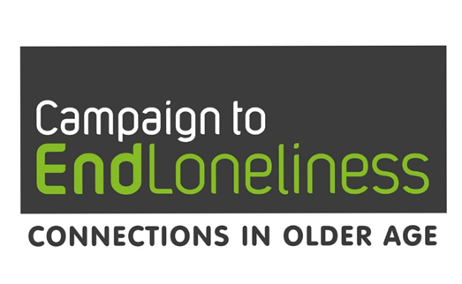
Psychology of Loneliness and why it matters
“a subjective and unwelcome feeling which results from a mismatch in the quality and quantity of social relationships we have and those that we desire”
Unwelcome feelings of loneliness can also affect social relationships
Greater focus on ‘social relationships’ than ‘unwelcome feelings’?

Slide 3
Psychology of Loneliness and why it matters
Risk factors for loneliness
What we know - living alone, poor health and mobility, poverty, life events and transitions amongst others
We know less about how someone perceives their situation and how able they feel to respond
“Yeah, I think you miss
somebody and you miss them
being there, but the loneliness
is in your head, isn’t it?”

Slide 4
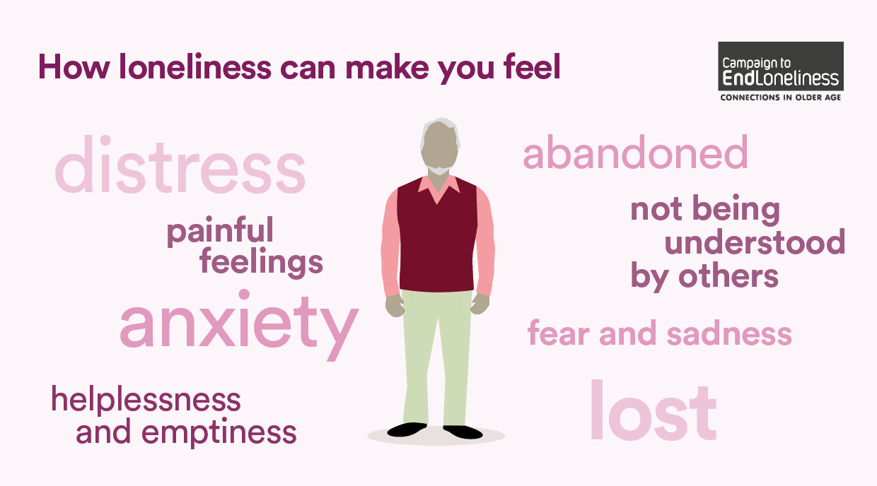

Slide 5
Psychological factors that affect loneliness
Extensive scoping review
Loneliness & Social Isolation in Mental Health Network, UCL
academic literature
reports from Third Sector
stakeholder consultation
Identified psychological factors that
increase likelihood of
trigger
maintain loneliness
Factors overlap and interact

Slide 6
Attributional style – how someone understands the reason for their loneliness
Internal
to do with themselves
External
to do with the situation
Stable
unlikely to change
Variable
changeable
People who are lonely can understand the reasons for their experience in different ways
Motivation
Self-esteem and self-efficacy

Slide 7
Social cognition – how people perceive or make sense of social situations
Loneliness can make you anticipate and interpret social situations differently
Fearful, sensitive to social rejection cues, feel a burden, greater distrust
“ I put my coat on and get the keys, but as soon as I wanted to step out, I couldn’t come out. I was really frightened to come out, you know, for some reason, I couldn’t come out.”
Notes:
Further withdrawal and loneliness worse

Slide 8
Mental health and cognitive impairment
Loneliness Depression, anxiety especially
social anxiety
Does alleviating one have an effect on the other?
Loneliness Dementia
Less social participation - less cognitive or sensory stimulation?

Slide 9
Influence of wider society and cultural norms
Social identity
The groups we feel part of or excluded from because of how we see ourselves
E.g. activities for ‘older people’
Ageism
Internalised – what people expect of themselves as they age
Societal – how society perceives older people and their value
E.g. believing loneliness is inevitable in later life means more likely to experience it.

Slide 10
Psychology of Loneliness
Social cognition
Self-esteem, self-efficacy
Mental health
Cognitive impairment
Personality
Difficult early life
Coping styles
Social identity
Ageism
Attributional style
It is clear that psychological factors have a part to play in our understanding of loneliness
What psychological techniques can be used to address them so we can better support people who are lonely?

