Slide 1




Psychological approaches that show promise Guy Robertson
Presentation slide title
Supported by

Slide 2
Psychological Approaches
Various psychological approaches can produce more awareness and control over thoughts, feelings and behaviours
Evidence base
meta-analysis (Masi et al., 2011) found that the most effective loneliness interventions addressed ‘maladaptive social cognition’ – i.e. negative thoughts about self-worth and the perceptions of others.
UCL literature review concluded – “There is preliminary research evidence that interventions that address the psychological factors involved in loneliness can be successful ….though many have not yet been fully evaluated. The strongest research evidence was found for cognitive behavioural interventions … which are designed to change individuals’ thoughts and feelings about loneliness…”
Notes:
Loneliness is a feeling, induced by thoughts (beliefs, attitudes, interpretations etc), and resulting in certain behaviours
simply bringing lonely people together may not result in new friendships because the thoughts and behaviors of lonely individuals makes them less attractive to one another as relationship partners
Masi - the interventions that addressed maladaptive social cognition yielded greater reductions in loneliness compared to the other intervention types. Although none of studies that addressed social cognition utilized precisely the same intervention, all included a form of cognitive behavioural therapy or psychological reframing. Our meta-analysis suggests certain interventions, particularly those which use cognitive behavioural therapy, can reduce loneliness.
UCL
“Initial Evidence Review: Strategies for encouraging psychological and emotional resilience in response to loneliness"
Authors: UKRI Loneliness and Social Isolation in Mental Health Research Network based at UCL

Slide 3
Overview of Approaches
Cognitive Behavioural Therapy
Mindfulness
Positive Psychology
Notes:
Key intersections
Awareness of thoughts and feelings
Thought patterns can be habitual and when negative can be problematic
Changing thinking can change feelings

Slide 4
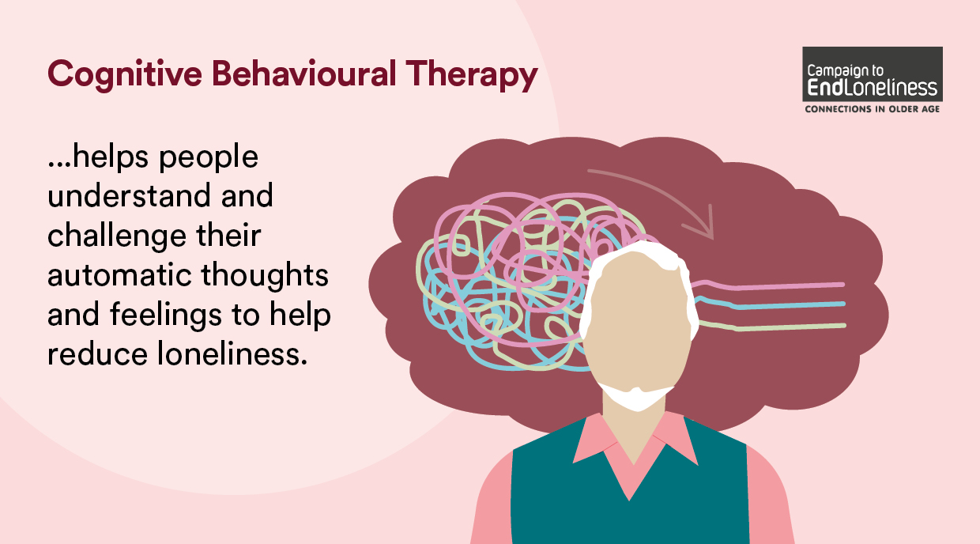
Cognitive Behavioural Therapy
Notes:
Enables better understanding of thoughts, feelings and behaviours
Attention to awareness of the content of instinctive thoughts
Identifies habitual negative thinking patterns
Provides strategies to change thinking patterns and beliefs about self and others to more helpful positive ones

Slide 5
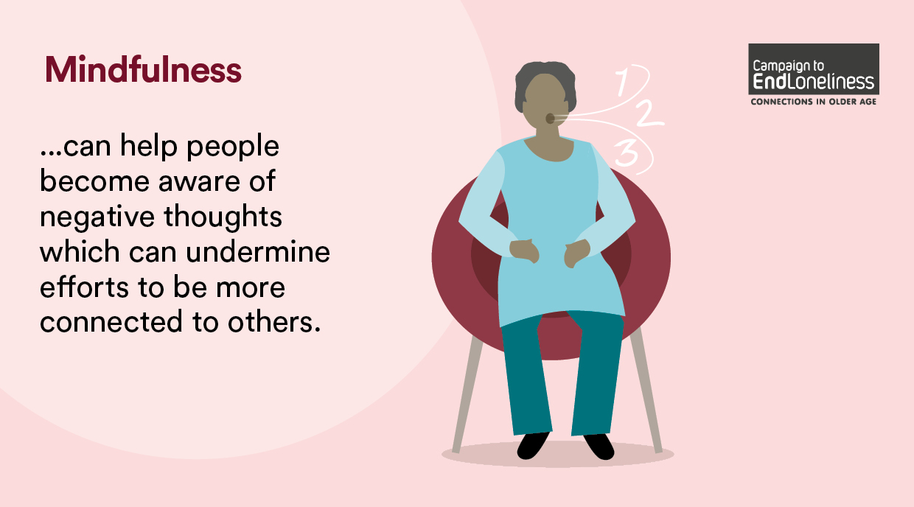
Mindfulness
Notes:
The awareness that arises from paying attention, on purpose, in the present moment and non-judgmentally
Awareness of thoughts and self-talk and the potential harm of the ‘uncontrolled mind’
Awareness of the body as a means of breaking thought obsession
Awareness that ‘thoughts are not facts’
De-centering – creating space from thoughts to allow choice about how to react
Practice effective at countering rumination

Slide 6
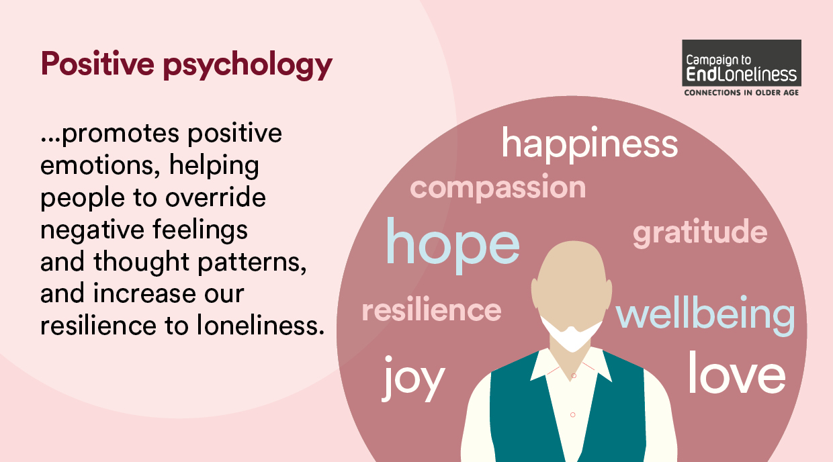
Positive Psychology
Notes:
“One of the most significant findings in psychology … is that people can choose the way they think” – Martin Seligman
Techniques to produce positive emotions with the intention to override negative ones
From ’learned helplessness’ to learning optimism
Main framework for promoting wellbeing is PERMA:-
P - positive emotions
E - engagement in satisfying tasks
R - relationships - communicating positively with other people
M - meaning and sense of purpose in life
A - achievement – setting and attaining meaningful goals in life
Other approaches
Acceptance and commitment therapy – a blend of CBT & Mindfulness - a form of behavioural therapy that combines mindfulness skills with the practice of self-acceptance.
reminiscence therapy (Brimelow et al 2017; Chiang et al 2010; Gaggioli et at 2014; Taragu et al 2019)
humour therapy (Tse et al 2010).

Slide 7
Limitations
Report is a first step
Limited research in this area emphasises the need to look to other sources of knowledge and to learn from innovative practice and lived experience.
Other approaches and blendings may be helpful (eg counselling, reablement and psycho-educational interventions etc).

Slide 8
Call to Action
Using the information in this report, we call for organisations to:
identify which aspects of their work include knowledge of the psychology of loneliness
design future programmes of work to explicitly include psychological approaches to loneliness
evaluate the impact of these programmes on reducing loneliness.
This will help to identify which factors or combination of factors are effective at reducing loneliness, and for whom, and to further develop the evidence base for loneliness interventions.

Slide 9

Contact Us
Join us www.campaigntoendloneliness.org/support-us
Twitter @EndLonelinessUK
Facebook @Thecampaigntoendloneliness
Email Us info@campaigntoendloneliness.org.uk

