Slide 1
Understanding Loneliness: The Challenge of Christmas
25 February 2014
#ChristmasAlone / @EndLonelinessUK / @IndependentAge

Slide 2
Kate Jopling
Campaign to End Loneliness
#ChristmasAlone / @EndLonelinessUK / @IndependentAge

Slide 3
What is loneliness?
Loneliness: The unwelcome feeling of a gap between the social connections we want and the ones we have. It can be:
Social or emotional
Transient, situational or chronic
Social isolation: is objective – a measure of contacts or interactions
Solitude: “Language... has created the word "loneliness" to express the pain of being alone. And it has created the word "solitude" to express the glory of being alone.” [Paul Johannes Tillich]

Slide 4
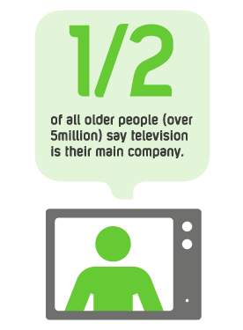
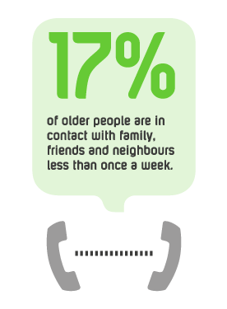
Loneliness in the UK
Over half (51%) of all people aged 75 and over live alone (ONS, 2010)
A higher % of women than men report feeling lonely “some of the time” or “often” (ONS, 2013)
www.campaigntoendloneliness.org.uk

Slide 5
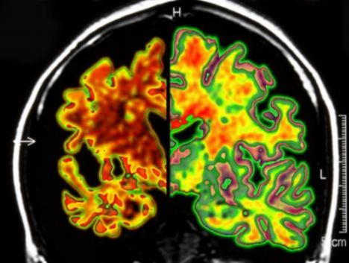
Loneliness and health: The evidence
Loneliness has negative effects on health. It:
Increases risk of depression (Green et al, 1992)
Affects biological stress mechanisms (Steptoe et al., 2004)
Is linked to an 64% increased risk of developing clinical dementia (Holwerda et al, 2012)
Makes people more likely to rate their health as poor (Stickley et al., 2013; Kaasa, 1998)
Is an equivalent risk factor for early mortality to smoking 15 cigarettes a day, and has a greater impact than other risk factors such as physical inactivity and obesity. (Holt-Lunstad, 2010)
Increases the risk of high blood pressure (Hawkley et al, 2010)

Slide 6
Loneliness and health: The evidence
Loneliness and isolation contribute to harmful health
behaviours. Lonely people:
Can be uniquely vulnerable to alcohol problems (Wadd et al., 2011)
Eat less well: Older adults who live alone and have infrequent contact with friends eat fewer vegetables each day. (Conklin et al., 2013)
Are more likely to be smokers and more likely to be overweight (Lauder et al., 2006.)
Are less likely to engage in physical activity and exercise (Hawkley et al., 2009; Newall, et al.,2013)

Slide 7
Loneliness is a public health issue
Department of Health: “Public health is about helping people to stay healthy, and protecting them from threats to their health”
Faculty of Public Health: "The science and art of promoting and protecting health and well-being, preventing ill-health and prolonging life through the organised efforts of society”.
Loneliness fits the bill…
It’s a threat to health
Lonely people struggle to make healthy choices
It requires a whole society response
Linked to a range of other recognised public health issues – e.g. alcohol, healthy eating etc.
Notes:
7

Slide 8
Why Christmas?
Many day-to-day services shut down
Greater public consciousness leads to more ad hoc services, and increased willingness to help
Perception that loneliness is more acute…and some good reasons this may be true
Notes:
8

Slide 9
Risk factors for loneliness
A range of factors increase our vulnerability to loneliness:
Wider society:
Transport
Physical environment
Community
Housing
Technology
Crime
Population changes
Personal:
Poor health
Sensory loss
Loss of mobility
Less income
Bereavement
Retirement
Other change, e.g. giving up driving
Loneliness can happen at any age, but risk factors increase as we get older.

Slide 10
What is the Campaign to End Loneliness?
A network of national, regional and local organisations and people working together through community action , good practice , research and policy to create the right conditions to reduce loneliness in later life.
We aim:
To improve the quality and quantity of services that tackle loneliness amongst older people
To improve the commissioning of services that really work in combatting loneliness
To ensure that the best services are replicated, and the evidence base is built
Notes:
10

Slide 11
What does the Campaign to End Loneliness do?
Three main areas of work:
Building and sharing the evidence
Campaigning
Sharing resources and learning together
www.campaigntoendloneliness.org.uk
Notes:
11

Slide 12
Sharing resources: Our Learning Network
Ending the isolation of loneliness services!
Sharing the research, and how it can be put into practice
Linking people up across the country
Working to develop new measures
Workshops like today: our Understanding Loneliness series
www.campaigntoendloneliness.org.uk

Slide 13
Today’s challenge
Learn from experience and research
Explore what we need to do to improve older people’s experience at Christmas
Plan how we make Christmas last all year
Our hope: A clear next step for everyone
A new contact to make?
A new organisation to call?
A new idea to implement?

Slide 14
Sophie Andrews
The Silver Line
#ChristmasAlone / @EndLonelinessUK / @IndependentAge

Slide 15
Caroline Billington
Community Christmas
#ChristmasAlone / @EndLonelinessUK / @IndependentAge

Slide 16
The reality
Christmas Day is not ‘just another day’ – for many it is much worse
A social not a religious need to do something

Slide 17
Personal background
Starting in 2007, inspired by legacy
Motivation/event
Limitations
Pilots in 2011/12
Launch 2013
Fill gaps 2014

Slide 18
Our vision
No elderly person in the UK should be alone on Christmas Day unless they want to be.
Our beneficiaries
Older people
– their neighbours, carers and distant relatives
Our communities
Service providers

Slide 19
What do we do?
Provide a web presence
Identify existing provision and hence gaps
‘one stop shop’ to find companionship on Christmas Day
Create national awareness to reach out and motivate local action
individuals and organisations
Support organisers
Guidance notes and other resources
Web presence
No elderly person in the UK should be alone on Christmas Day unless they want to be.

Slide 20
What works well
All of the above………………as far as they go.
Web
Awareness and Motivation
Support
Independence allowing collaboration
Legacy
– communities, individuals, organisations
Exploding a couple of myths
Availability of local funds
Availability of local volunteers
No elderly person in the UK should be alone on Christmas Day unless they want to be.

Slide 21
Challenges
The size of the problem - we need to do more
Web
Awareness and Motivation
Support
Why is this so hard?
Timing – only once a year, lack of focus rest of year
Availability of organisers – for different delivery mechanisms
Reaching out to those in need
Alone vs lonely
Charity vs companionship
Collaboration to ensure Christmas Day ‘covered’
Measuring need and impact (including legacy)
No elderly person in the UK should be alone on Christmas Day unless they want to be.

Slide 22
No elderly person in the UK should be alone on Christmas Day unless they want to be.

Slide 23
Table Discussion
What did you do over Christmas 2013? What went well?
What were the challenges that you faced as a service provider? Or What were your concerns for older people you could not support over Christmas?
What lessons did you learn?
#ChristmasAlone / @EndLonelinessUK / @IndependentAge

Slide 24
Ian Richards
Crisis at Christmas
#ChristmasAlone / @EndLonelinessUK / @IndependentAge

Slide 25
Natasha Singarayer
The Abbeyfield Society
#ChristmasAlone / @EndLonelinessUK / @IndependentAge

Slide 26
“I saw single elderly people sitting on park benches or looking out of windows, coming out of public libraries or walking aimlessly down the streets.”
Richard Carr-Gomm on why he bought first Abbeyfield House in 1956

Slide 27
528 houses throughout the UK
104 international houses in 13 countries
Over 8000 older people living in a supported family atmosphere
Range of accommodation from sheltered housing to dementia care
Approximately 9000 volunteers
Abbeyfield In top 30 UK charities for volunteer numbers
Multiple award winning:
Best UK Dementia Care Home 2012, Best UK Care Home 2010
Times Appeal Charity 2013

Slide 28
Coping at Christmas is an annual Abbeyfield campaign aimed at older people who would otherwise be alone over the festive period
In 2013, 130 Abbeyfield houses and homes up and down the UK opened their doors to over 55’s
Abbeyfield served hundreds of free Christmas dinners and up to a hundred older people stayed overnight in guest rooms
Abbeyfield’s Coping campaign was part-funded by a £25,000 donation from Royal Mail
Nearly 1000 Abbeyfield volunteers and staff were the life and soul of the Coping Campaign – without them it could not have happened.

Slide 29
What Amanda and Barbara said....

Slide 30
26 broadcast
80 print articles
Times feature
10 MP visits

Slide 31
Volunteer enquiries increased by 297% this year.
Within this year’s campaign, Abbeyfield gained 92 volunteer enquiries – considerably more than 2012’s 31 enquiries.
Ten of this year’s volunteers have expressed interest in becoming long term volunteers with Abbeyfield, as a direct result of the Coping initiative.

Slide 32
“Then a woman from Abbeyfield in Accrington rang and said I could go there for Boxing Day.” “She picked me up and took me over. I went there on New Year’s Day as well.
Out of the darkness these strangers came to shine a light into a very dark place.
They were all so very kind to me and they really do make a difference.” – Irene Newington

Slide 33
Table Discussion
What opportunities might Christmas present to my service, or the older people that I work with?
What one thing can I do now to take advantage of these?
#ChristmasAlone / @EndLonelinessUK / @IndependentAge

Slide 34
Dr Tracy Collins
University of Salford
#ChristmasAlone / @EndLonelinessUK / @IndependentAge

Slide 35
Context of the study
Widowhood in later life is more common for older women than older men (Hirst & Corden, 2010)
Social networks and social support are thought to help buffer such events and ease subsequent transitions (Momtaz et al., 2009)

Slide 36
Context of the study
Lack of longitudinal qualitative research exploring the personal communities of older widows experiencing transition in contemporary Britain (Collins, 2011)
I was particularly interested in older women’s personal communities and social practices and if and how they change during widowhood

Slide 37
Study design
Methodological approach – qualitative framework, longitudinal design
Purposive sample – 26 older widows, widowed between 1 and 3 years (transitional phase)
Method – series of three in depth interviews conducted over eighteen months, including the use of personal community diagrams to identify the structure of social networks, and Christmas and Christmas cards to further explore social relationships and practices
Analysis – thematic analysis of interview transcripts and content analysis of diagrams

Slide 38
Positive experiences of Christmas
Christmas as a reference point demonstrates a remembering of the past but also a looking to the future (Collins, 2013). The older widows experiences ranged from the positive to the negative

Slide 39
Family and friends
Many of the women gave accounts of a very special time of year, where close family, particularly intergenerational ties, and their kinship roles were positively reinforced, helping to ease their transition
The continuity of friendships was also apparent with friends featuring in the celebrations of some of the older widows and in the exchange of cards of many of the older widows

Slide 40
Organisations
The importance of continuous ties with organisations, such as voluntary agencies and the Church, was also apparent for many of the older widows. These associations ranged from the relatively superficial to being more ‘friend-like’ in nature.
For Veronica, who is childless, attending various churches and associating with different people has led to the formation of some supportive friendships in widowhood, providing local support in the absence of family

Slide 41
Personal continuity and activation
Rather than be on her own, Veronica, who was not invited to her sister’s Christmas celebrations, explained how she took the initiative and created her own special day:
‘I thought to myself ‘Well I’m going to have to spend Christmas on my own then’, and I thought ‘Well you are not Veronica, because you can invite people’. I invited two friends, who live just at the back here and go to church . . . I wasn’t moping, thinking ‘Oh nobody wants me’, I sort of made an effort’

Slide 42
Christmas as a catalyst for change
The Christmas and New Year period seemed to signify personal change for many of the women, motivating an engagement in new activities, such as voluntary work, or a change in approach to long-established practices, for example, some women went away for Christmas with friends or organisations

Slide 43
Negative experiences of Christmas
However, Christmas can be an isolating and excluding experience for some older widows, compounded by multiple challenges such as:
family friction
personal dependence
increasing frailty
a growing sense of passivity as established roles and relationships alter or are lost (Collins, 2014)

Slide 44
Social exclusion
For Mary, family friction between her four adult children, compounded by her being housebound, culminated in her spending Christmas alone at home:
‘I was here all on my own on Christmas day…and the same with new year. I didn’t go anywhere, I was here, you know, so I was glad when they’d both gone…Christmas and the new year, you know. So I just had the television on, to pass the time away, you know.’

Slide 45
Cultural exclusion
Mary’s social and cultural exclusion was starkly illustrated as she described her Christmas meal, which is vastly different to that which many people in Britain enjoy on Christmas Day:
‘…I had a tin of vegetable soup on Christmas day for my dinner, with a mince pie, and I had a tin of tomato soup and a mince pie on Boxing day.’

Slide 46
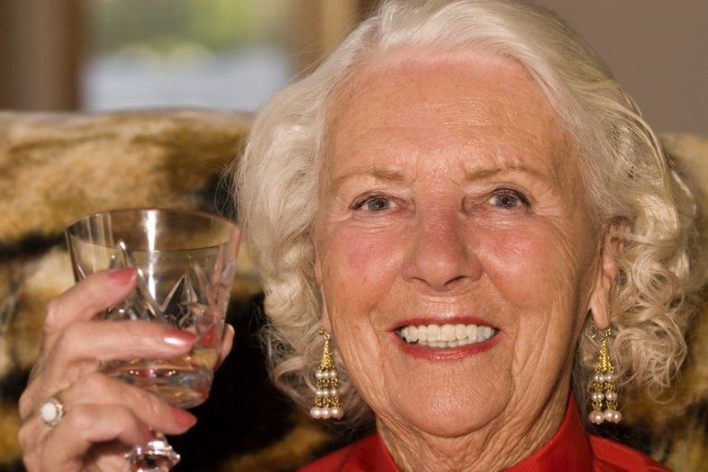
Implications for future Christmas events
Christmas events have the potential to bring older people together and provide an opportunity for people to develop friendships throughout the year

Slide 47
Implications for future Christmas events
Work collaboratively with older people, local services and organisations (ensure older people know about an event in their community and can be actively involved)
Consider how to engage ‘harder to reach’ older people
Possible challenges: transport, mobility, stigma, lack of confidence, family friction/obligation, gender, culture
Intergenerational events – future event involving students at the university…

Slide 48
Evaluation
Listening events, working with older people and local/national organisations – establishing the need, ‘joined up working’
Exploring older peoples experiences of events through in depth interviews, focus groups and/or surveys, questionnaires – adding to the evidence base

Slide 49
Evaluation
Plan for evaluation prior to or early in an initiative - if successful, what expect to see? What measures/indicators available?
Important to consider WHO/WHAT will be impacted on; HOW they will benefit; through WHAT mechanisms; under WHAT conditions/circumstances
Evaluate structures, process, outcomes and impact – note context
Be mindful of immediate, short and long-term impacts, unexpected impacts, (perceived) positive and negative impacts
Participatory evaluation allows for formative feedback to inform change/improvement and promotes ownership
Need to engage stakeholders early and plan processes (service design, research design) with them early

Slide 50
Evaluation
Would you agree to take part in a project/study for ugly people?
So why would someone want to identify themselves/be identified as lonely/isolated?
Should we be asking people what language to use e.g. people who would like greater social networks; people who want to get out and about more; people who want more company or contact with others in their lives?
Involving the public and others with a relevant view/perspective in study design can help us use the right language; identify and recruit participants into ‘loneliness’ research
On-going involvement can enhance the research process e.g. older adults as co-researchers (as experienced in the Saying Hello study – Big Lottery) see http://usir.salford.ac.uk/12873/ and http://usir.salford.ac.uk/12871/

Slide 51
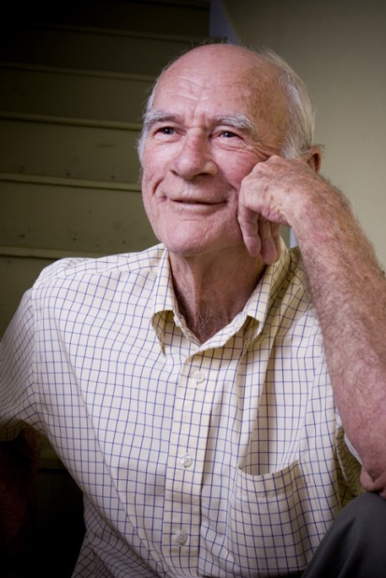
Further research
Post doctoral research with older widowers to explore gender differences, including the characteristics of social relationships and practices, during transition
Notes:
Women’s roles within the family – seen as kin keepers – different to men’s roles. Difference in friendships – women develop over the life course, keep in touch – are men the same or are men’s friendships more context specific – work/sport etc?
51

Slide 52
References
Collins, T. 2011. Managing transition: a longitudinal study of personal communities in later life widowhood. PhD, Keele University. Available at http://usir.salford.ac.uk/15823/
Collins, T. 2013. Remembering the past, looking to the future: Christmas as a symbol of change in later life widowhood. Ageing and Society, Available on CJO 2013 DOI: 10.1017/SO144686X13000329
Collins, T. 2014. Managing widowhood in later life: the challenges encountered. International Journal of Therapy and Rehabilitation, Vol. 21, Iss. 2, 05 Feb 2014, pp 69 – 76
Hirst, M. and Corden, A. 2010 ‘Change in living arrangements following death of a partner in England and Wales, 1971-2001’ Population Trends, nr 141 Autumn. Available at http://www.statistics.gov.uk/articles/population_trends/11-poptrends141-hirst.pdf Accessed on 22nd April 2011, 12.25pm.
Momtaz, Y., Hamid, T., Yahaya, N. and Ibrahim, R. 2009. ‘Widowhood and psychological well-being among older Malaysians: mediating effect of social network’ Indian Journal of Social Work, 70, 3, 375-390.

Slide 53
Tina Varns
Waitrose
#ChristmasAlone / @EndLonelinessUK / @IndependentAge

Slide 54
Table Discussion
Who could I collaborate with during Christmas 2014?
How can I ensure that Christmas can be used to improve my year-round services?
How will I know if we’ve been successful at reducing loneliness at Christmas, and beyond?
#ChristmasAlone / @EndLonelinessUK / @IndependentAge

